Slide 1
Opto-Electronics
(ET – 421)
FALL-213
Lecture# 02

Slide 2
Course Project
Work in a single or a group of two.
Email me your group member(s) name(s) and roll number(s) along with 3 proposed papers(Opto-electrnics) by 22th of sep 2013.
Final decision will be informed to you by the email. Any changes can be discussed till Monday 30th of sep before 3pm.
Each group will present, detailed Project proposal on 14th of oct.
After approval of proposal, each group will submit a implemented/review paper(follow IEEE format) till 25th Nov 2013.
The papers shall be from any IEEE Conferences/ Journals
The publication year should be one of these: 2010, 2011 , 2012 and 2013.

Slide 3
Lecturer out lines
Digital Data Communication Concepts
Structure of optical fibers
Basic optical laws and Definitions

Slide 4
Digital Data Communication Concepts
Analog Signal
Sampling
Quantization
Digital signal

Slide 5
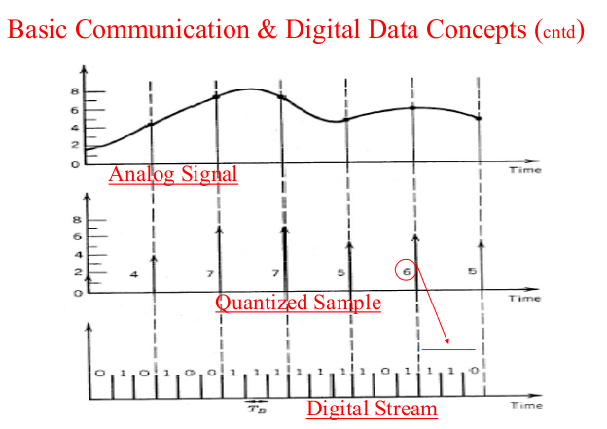

Slide 6
Data rate
Bit rate=BW*(samples/cycle)*(bits/sample)

Slide 7
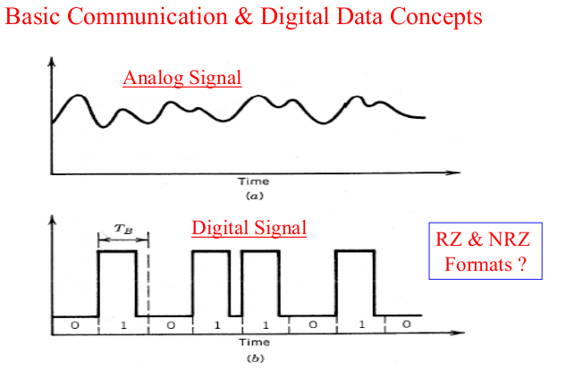

Slide 8
Practice questions??
What is difference between?
Bit rate
Baud rate
Channel capacity
Is Bit rate and Baud rate are equal in RZ??

Slide 9
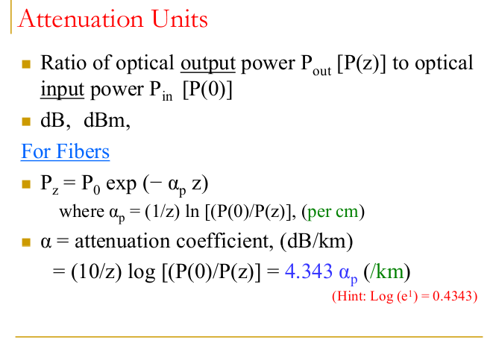

Slide 10
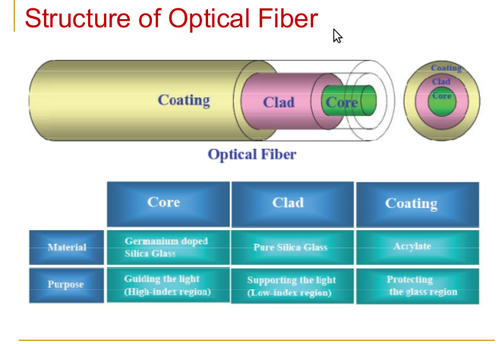

Slide 11
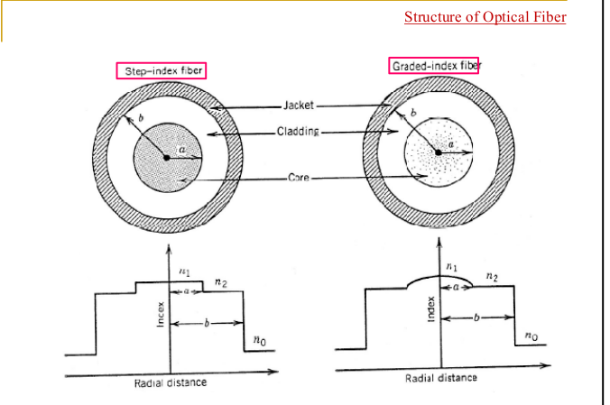

Slide 12
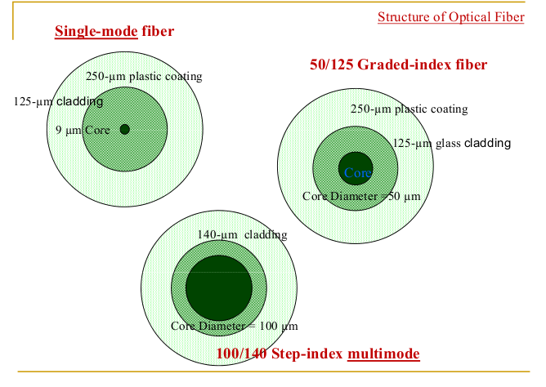

Slide 13
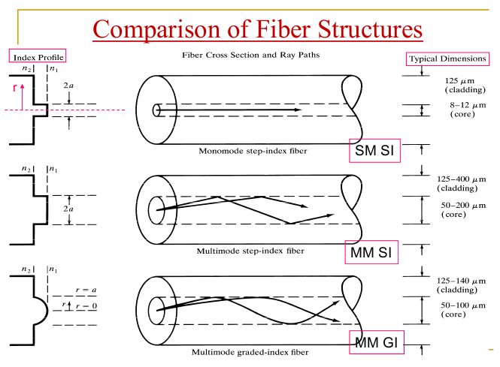

Slide 14
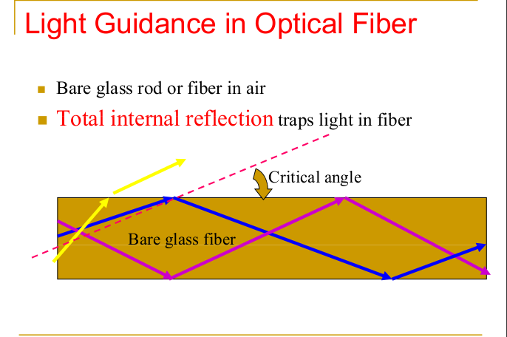

Slide 15
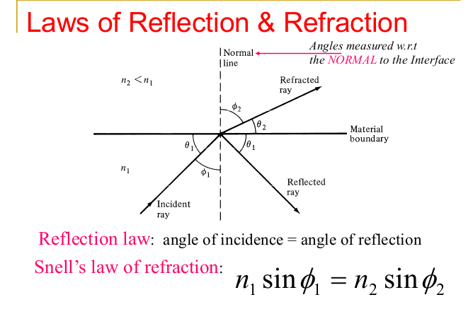

Slide 16
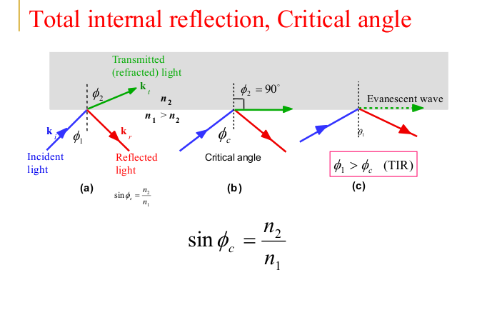

Slide 17
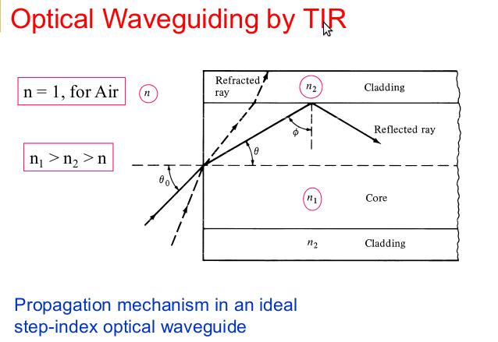

Slide 18
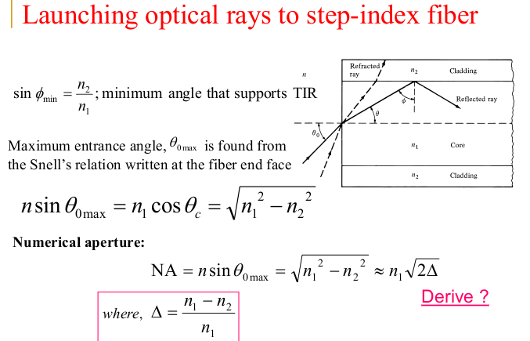

Slide 19
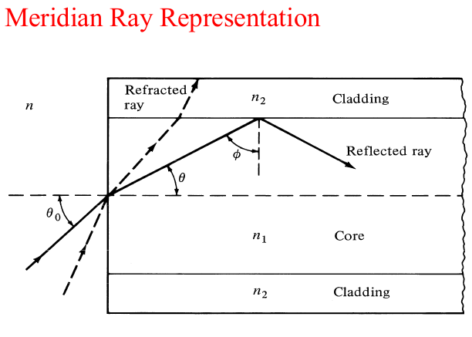

Slide 20
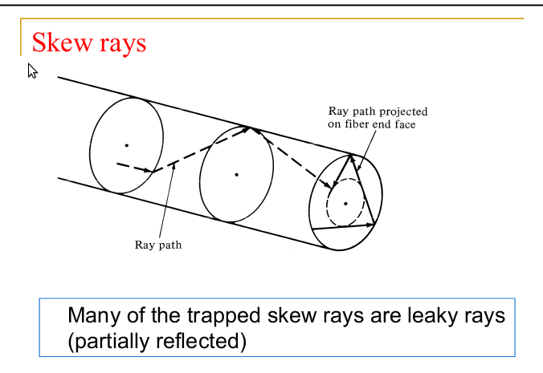

Slide 21
Axial ray
The axial ray is a particular ray that just happens to travel straight through the center of the core

Slide 22
Assignment#01
Due date is 16th Sep
before the start of the class.
Text book chapter 01 questions
1.1,1.3,1.5,1.6,1.7,1.8,1.9,1.10,1.11,1.12

